Slide 1
Probability Models
Lecture 2
Robert Kissell
Fall 2017

Slide 2
Lecture - Outline
Ordinary Least Squares Review
First Order Conditions (FOC)
w/o & w/ Constraint
Regression Examples
Excel, MATLAB
Probability Models
Logit Model
Solution using MLE
Math Problems
FOC, FOC w/1constraint, FOC w/2 constraints

Slide 3
OLS Regression Review

Slide 4
Review of OLS Regression
Is the Regression Model Linear
Linear in the Parameters
Can the Regression Model be Linearized?
E.g., Using Logs or Logistic Regression
Solve The Model
Calculate First Order Conditions (FOC)
Estimate Regression Parameters and Statistics using OLS
Evaluate the Model Solution
Are the Explanatory Factors Statistically Significant?
R2, T-Test, F-Test
Verify all OLS Properties
Linear Model, Error Term has Mean Zero, No Autocorrelation (Error Term), No Heteroscedasticity Error Term), Explanatory Factors are All Independent, Error Term is Independent of all Explanatory Factors (Error Term and Factors).
If any of the OLS Properties are violated, then the analyst needs to make adjustments to the data.

Slide 5
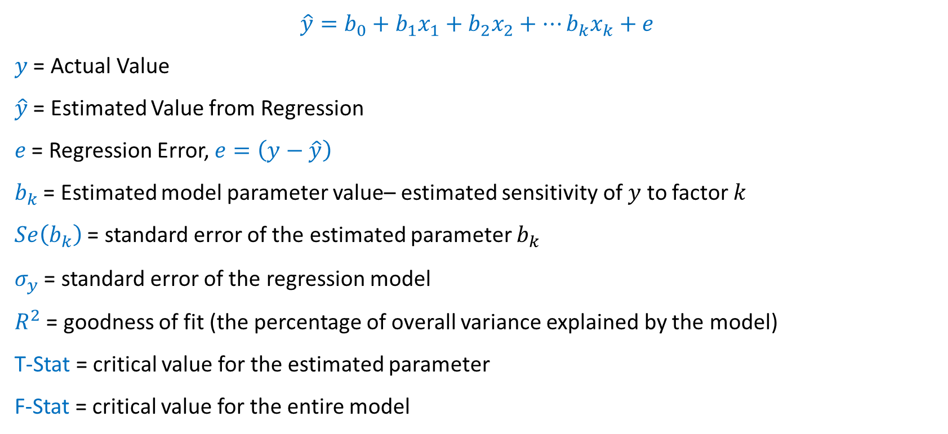
Linear Regression Model:
$$\hat{y}=b_{0}+b_{1}x_{1}+b_{2}x_{2}+…b_{k}x_{k}+e$$
$y$ = Actual Value
$\hat{y}$ = Estimated Value from Regression
$e$ = Regression Error, $e=\left(y−\hat{y}\right)$
$b_{k}$ = Estimated model parameter value– estimated sensitivity of $y$ to factor $k$
$Se\left(b_{k}\right)$ = standard error of the estimated parameter $b_{k}$
$σ_{y}$ = standard error of the regression model
$R^{2}$ = goodness of fit (the percentage of overall variance explained by the model)
T-Stat = critical value for the estimated parameter
F-Stat = critical value for the entire model

Slide 6
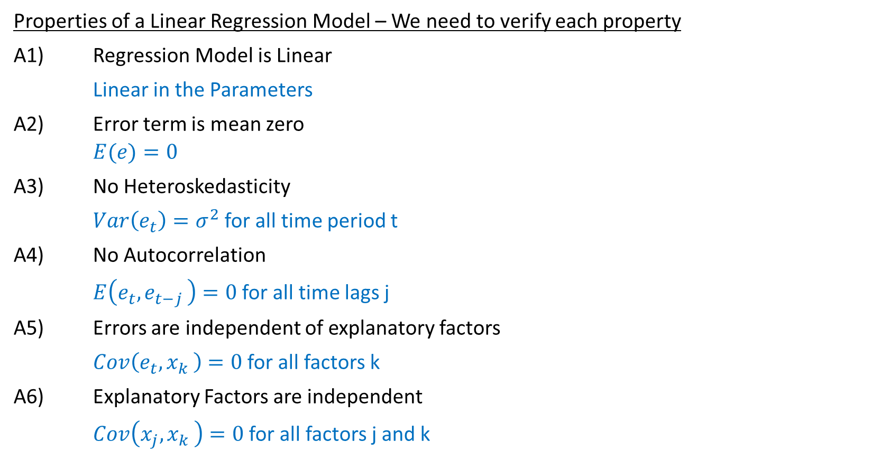
Linear Regression Model – OLS Properties
Properties of a Linear Regression Model – We need to verify each property
A1) Regression Model is Linear
Linear in the Parameters
A2) Error term is mean zero
$$E(e)=0$$
A3) No Heteroskedasticity
$Var\left(e_{t}\right)=σ^{2}$ for all time period t
A4) No Autocorrelation
$E\left(e_{t}{,e}_{t−j}\right)=0$ for all time lags j
A5) Errors are independent of explanatory factors
$Cov\left(e_{t}{,x}_{k}\right)=0$ for all factors k
A6) Explanatory Factors are independent
$Cov\left(x_{j}{,x}_{k}\right)=0$ for all factors j and k

Slide 7

Example: Estimating Linear Model Parameters
Minimize Sum of Square Error:
$$\hat{y}=b_{0}+b_{1}x_{1}+ …+b_{k}x_{k}$$
$$L=\sum{{\left(y−\hat{y}\right)}^{2}}$$
$$L=\sum{{\left(y−\left(b_{0}+b_{1}x_{1}+ …+b_{k}x_{k}\right)\right)}^{2}}$$
$$L=\sum{{\left(y−b_{0}−b_{1}x_{1}− …−b_{k}x_{k}\right)}^{2}}$$

Slide 8
Linear Regression: First Order Conditions

Slide 9

Step 1 – Solve First Order Conditions
Minimize Sum of Square Error:
$$L=\sum{{\left(y−\hat{y}\right)}^{2}}=\sum{{\left(y−b_{0}−b_{1}x_{1}− …−b_{k}x_{k}\right)}^{2}}$$
First Order Conditions:
$$\frac{∂L}{∂b_{0}}=2\sum{\left(y−b_{0}−b_{1}x_{1}− …−b_{k}x_{k}\right)\left(−1\right)=0}$$
$$\frac{∂L}{∂b_{1}}=2\sum{\left(y−b_{0}−b_{1}x_{1}− …−b_{k}x_{k} \right)\left(−x_{1}\right)=0}$$
$$\frac{∂L}{∂b_{2}}=2\sum{\left(y−b_{0}−b_{1}x_{1}− …−b_{k}x_{k} \right)\left(−x_{2}\right)=0}$$
$$⋮$$
$$\frac{∂L}{∂b_{k}}=2\sum{\left(y−b_{0}−b_{1}x_{1}− …−b_{k}x_{k} \right)\left(−x_{k}\right)=0}$$

Slide 10
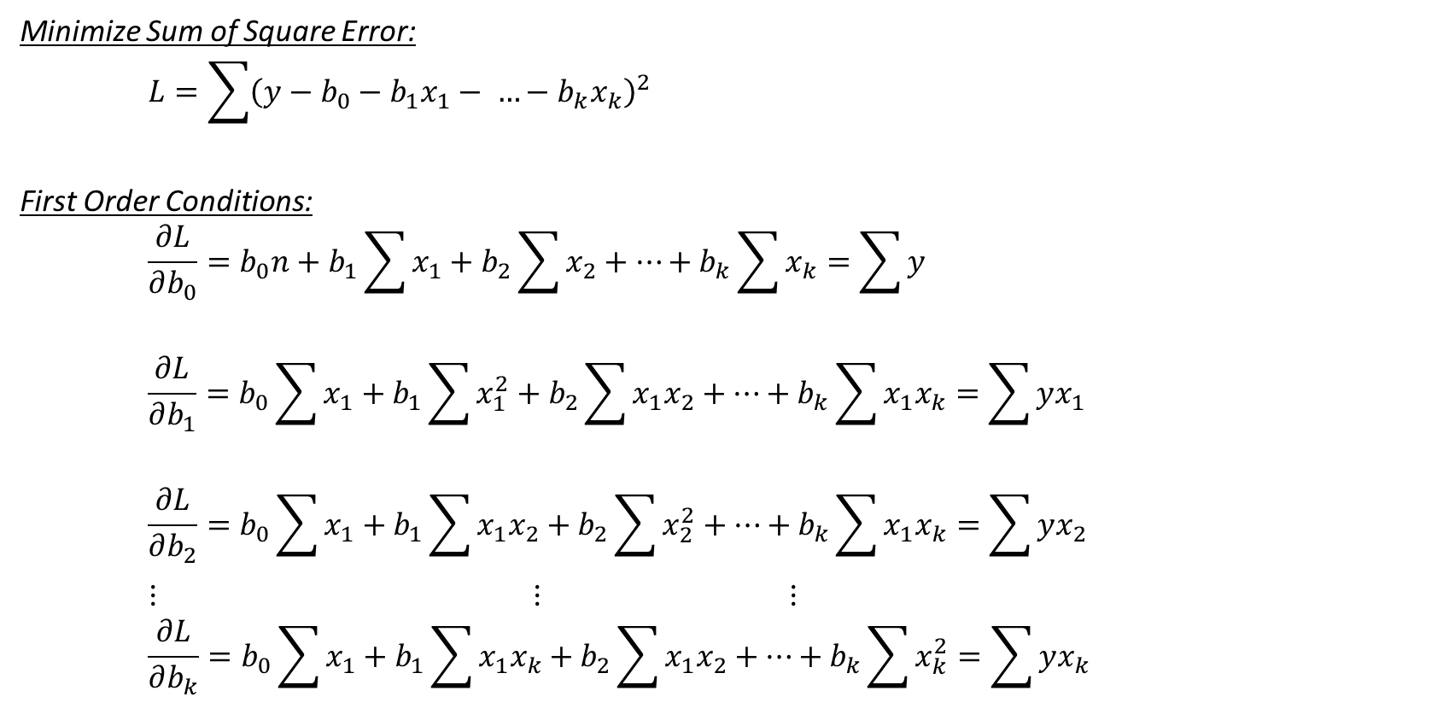
Step 2 – Simplify & Reduce First Order Conditions
Minimize Sum of Square Error:
$$L=\sum{{\left(y−b_{0}−b_{1}x_{1}− …−b_{k}x_{k}\right)}^{2}}$$
First Order Conditions:
$$\frac{∂L}{∂b_{0}}=b_{0}n+b_{1}\sum{x_{1}}+b_{2}\sum{x_{2}}+…+b_{k}\sum{x_{k}}=\sum{y}$$
$$\frac{∂L}{∂b_{1}}=b_{0}\sum{x_{1}}+b_{1}\sum{x_{1}^{2}}+b_{2}\sum{x_{1}x_{2}}+…+b_{k}\sum{x_{1}x_{k}}=\sum{yx_{1}}$$
$$\frac{∂L}{∂b_{2}}=b_{0}\sum{x_{1}}+b_{1}\sum{x_{1}x_{2}}+b_{2}\sum{x_{2}^{2}}+…+b_{k}\sum{x_{1}x_{k}}=\sum{yx_{2}}$$
$⋮$ $⋮$ $⋮$
$$\frac{∂L}{∂b_{k}}=b_{0}\sum{x_{1}}+b_{1}\sum{x_{1}x_{k}}+b_{2}\sum{x_{1}x_{2}}+…+b_{k}\sum{x_{k}^{2}}=\sum{yx_{k}}$$

Slide 11

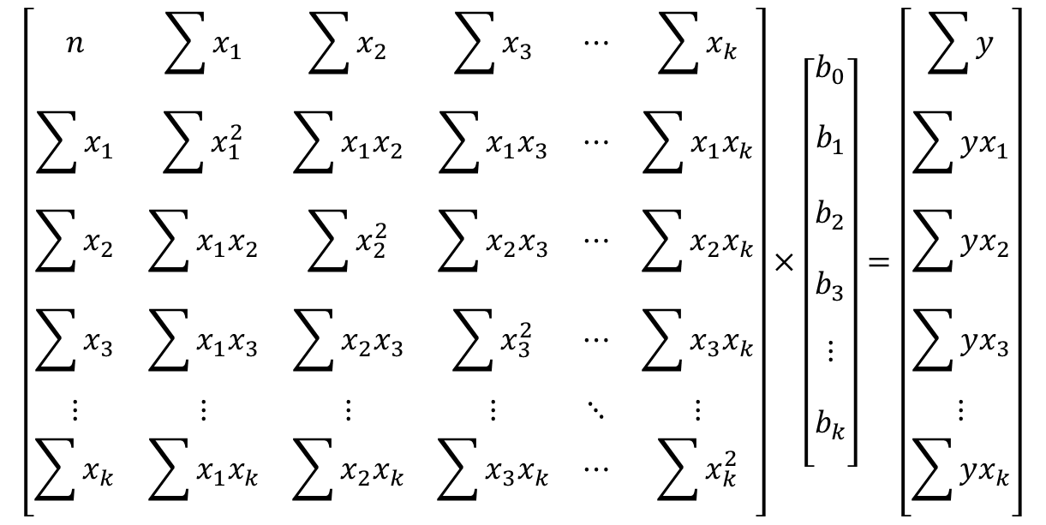
Step 3: Matrix Notation
$$X×b=Y$$
$$\left[\begin{matrix}n & \sum{x_{1}} & \sum{x_{2}} & \sum{x_{3}} & ⋯ & \sum{x_{k}} \\ \sum{x_{1}} & \sum{x_{1}^{2}} & \sum{x_{1}x_{2}} & \sum{x_{1}x_{3}} & ⋯ & \sum{x_{1}x_{k}} \\ \sum{x_{2}} & \sum{x_{1}x_{2}} & \sum{x_{2}^{2}} & \sum{x_{2}x_{3}} & ⋯ & \sum{x_{2}x_{k}} \\ \sum{x_{3}} & \sum{x_{1}x_{3}} & \sum{x_{2}x_{3}} & \sum{x_{3}^{2}} & ⋯ & \sum{x_{3}x_{k}} \\ ⋮ & ⋮ & ⋮ & ⋮ & ⋱ & ⋮ \\ \sum{x_{k}} & \sum{x_{1}x_{k}} & \sum{x_{2}x_{k}} & \sum{x_{3}x_{k}} & ⋯ & \sum{x_{k}^{2}}\end{matrix}\right]×\left[\begin{matrix}\begin{aligned}b_{0} \\ \end{aligned} \\ \begin{aligned}b_{1} \\ \\ b_{2} \\ \end{aligned} \\ \begin{aligned}b_{3} \\ \end{aligned} \\ \begin{aligned}⋮ \\ \end{aligned} \\ \begin{aligned}b_{k} \\ \end{aligned}\end{matrix}\right]=\left[\begin{matrix}\sum{y} \\ \sum{yx_{1}} \\ \sum{yx_{2}} \\ \sum{yx_{3}} \\ ⋮ \\ \sum{yx_{k}}\end{matrix}\right]$$

Slide 12

Step 4: Solving Parameters via Matrix Multiplication
$$Xb=Y$$
$$X^{′}Xb=X^{′}Y$$
$${\left(X^{′}X\right)}^{−1}X^{′}Xb={{\left(X^{′}X\right)}^{−1}X}^{′}Y$$
$$b={{\left(X^{′}X\right)}^{−1}X}^{′}Y$$

Slide 13
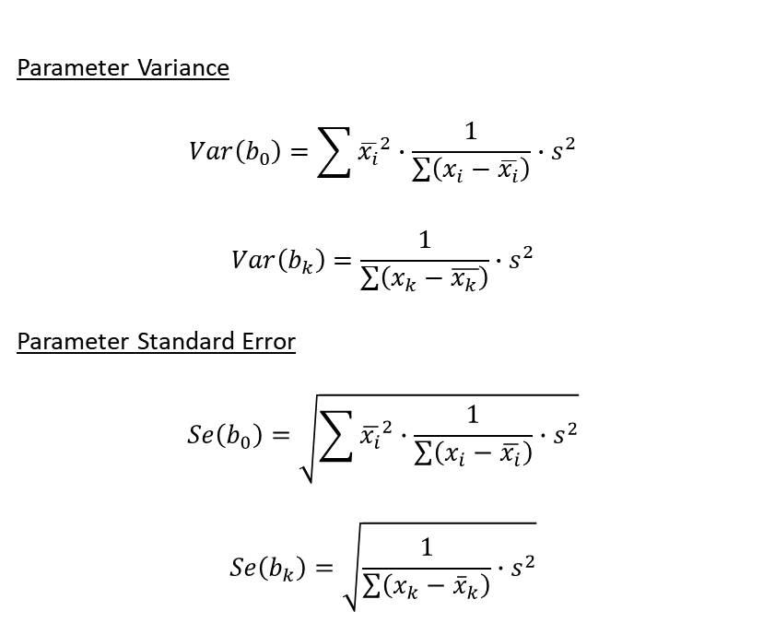
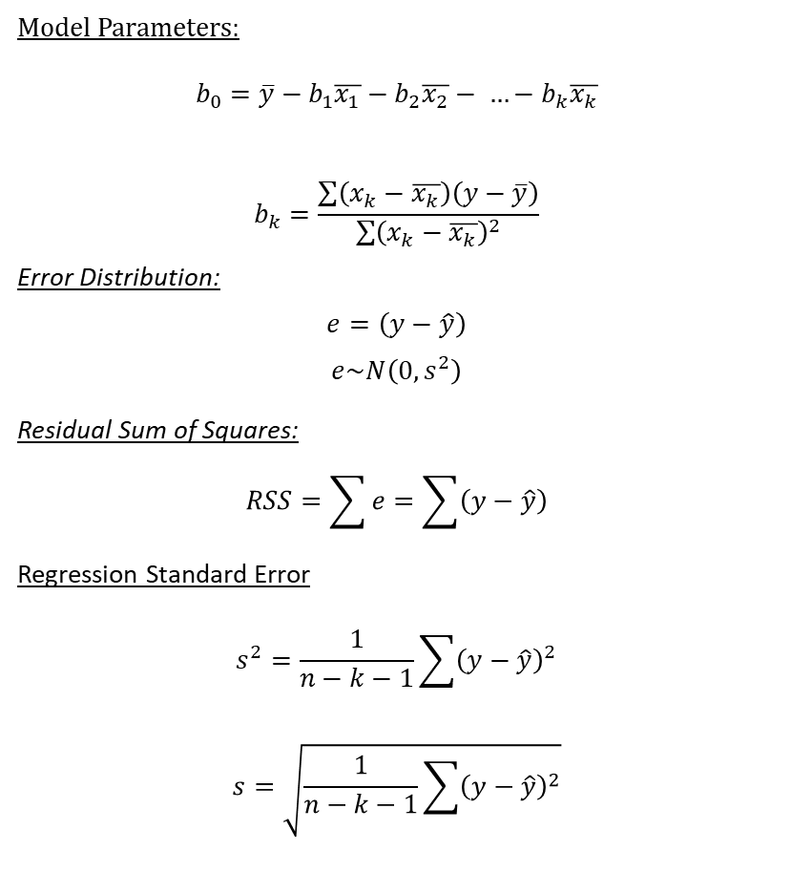
Solving Model Parameters
Model Parameters:
$$b_{0}=\overline{y}−b_{1}\overline{x_{1}}−b_{2}\overline{x_{2}}− …−b_{k}\overline{x_{k}}$$
$$b_{k}=\frac{\sum{\left(x_{k}−\overline{x_{k}}\right)\left(y−\overline{y}\right)}}{\sum{{\left(x_{k}−\overline{x_{k}}\right)}^{2}}}$$
Error Distribution:
$$e=\left(y−\hat{y}\right)$$
$$e\sim N\left(0,s^{2}\right)$$
Residual Sum of Squares:
$$RSS=\sum{e}=\sum{\left(y−\hat{y}\right)}$$
Regression Standard Error
$$s^{2}=\frac{1}{n−k−1}\sum{{\left(y−\hat{y}\right)}^{2}}$$
$$s=\sqrt{\frac{1}{n−k−1}\sum{{\left(y−\hat{y}\right)}^{2}}}$$
Parameter Variance
$$Var\left(b_{0}\right)=\sum{{\overline{x_{i}}}^{2}∙\frac{1}{\sum{\left(x_{i}−\overline{x_{i}}\right)}}}∙s^{2}$$
$$Var\left(b_{k}\right)=\frac{1}{\sum{\left(x_{k}−\overline{x_{k}}\right)}}∙s^{2}$$
Parameter Standard Error
$$Se\left(b_{0}\right)=\sqrt{\sum{{\overline{x_{i}}}^{2}∙\frac{1}{\sum{\left(x_{i}−\overline{x_{i}}\right)}}}∙s^{2}}$$
$$Se\left(b_{k}\right)=\sqrt{\frac{1}{\sum{\left(x_{k}−{\overline{x}}_{k}\right)}}∙s^{2}}$$

Slide 14
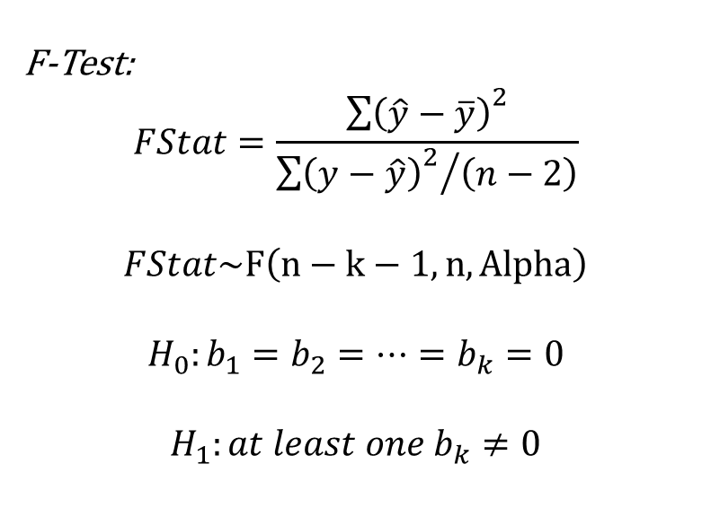

Solving Model Parameters
$R^{2}$ Goodness of Fit
$$R^{2}=1−\frac{\sum{e_{i}^{2}}}{{\sum{\left(y−\overline{y}\right)}}^{2}}$$
T-Stat (General)
$$TStat=\frac{b_{k}−b_{k}^{∗}}{Se\left(b_{k}\right)}$$
$$H_{0}:{b_{k}=b}_{k}^{∗}$$
$$H_{1:}b_{k}≠b_{k}^{∗}$$
$$TStat\sim T(df,Alpha)$$
F-Test:
$$FStat=\frac{{\sum{\left(\hat{y}−\overline{y}\right)}}^{2}}{{{\sum{\left(y−\hat{y}\right)}}^{2}}/{\left(n−2\right)}}$$
$$FStat\sim F\left(n−k−1,n,Alpha\right)$$
$$H_{0}:b_{1}=b_{2}=…=b_{k}=0$$
$H_{1}:at least one b_{k}≠0$

Slide 15
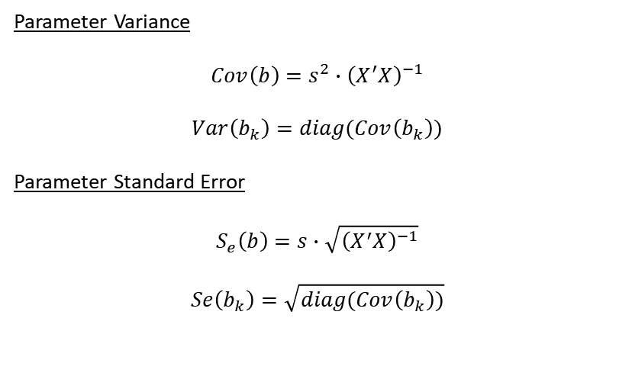

Solving Model Parameters – Matrix Algebra
Model Parameters:
$$b={{\left(X^{′}X\right)}^{−1}X}^{′}Y$$
Error Distribution:
$$e=\left(y−\hat{y}\right)=y−Xb$$
$$e\sim N\left(0,s^{2}\right)$$
Residual Sum of Squares
$$RSS=e^{′}e={\left(y−Xb\right)}^{′}\left(y−Xb\right)$$
Regression Standard Error
$$s^{2}=\frac{1}{n−k−1}{\left(y−Xb\right)}^{′}\left(y−Xb\right)$$
$$s=\sqrt{\frac{1}{n−k−1}{\left(y−Xb\right)}^{′}\left(y−Xb\right)}$$
Parameter Variance
$$Cov\left(b\right)=s^{2}∙{\left(X^{′}X\right)}^{−1}$$
$$Var\left(b_{k}\right)=diag(Cov\left(b_{k}\right))$$
Parameter Standard Error
$$S_{e}\left(b\right)=s∙\sqrt{{\left(X^{′}X\right)}^{−1}}$$
$$Se\left(b_{k}\right)=\sqrt{diag(Cov\left(b_{k}\right))}$$

Slide 16
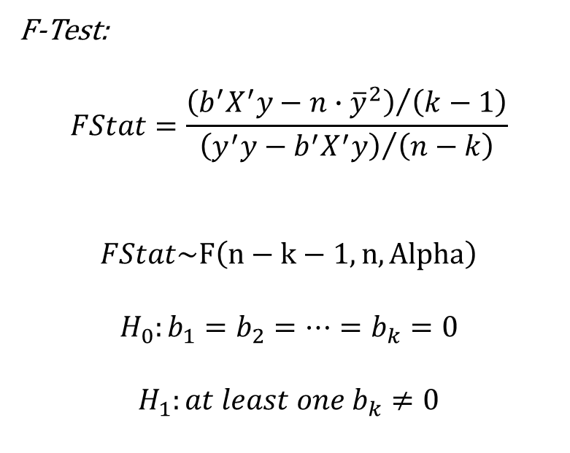
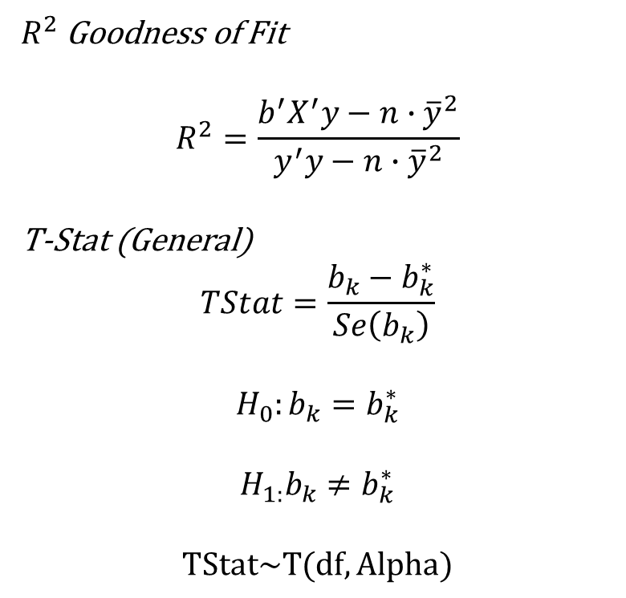
Solving Model Parameters – Matrix Algebra
$R^{2}$ Goodness of Fit
$$R^{2}=\frac{b^{′}X^{′}y−n∙{\overline{y}}^{2}}{y^{′}y−n∙{\overline{y}}^{2}}$$
T-Stat (General)
$$TStat=\frac{b_{k}−b_{k}^{∗}}{Se\left(b_{k}\right)}$$
$$H_{0}:{b_{k}=b}_{k}^{∗}$$
$$H_{1:}b_{k}≠b_{k}^{∗}$$
$$TStat\sim T(df,Alpha)$$
F-Test:
$$FStat=\frac{{\left(b^{′}X^{′}y−n∙{\overline{y}}^{2}\right)}/{\left(k−1\right)}}{{\left(y^{′}y−b^{′}X^{′}y\right)}/{\left(n−k\right)}}$$
$$FStat\sim F\left(n−k−1,n,Alpha\right)$$
$$H_{0}:b_{1}=b_{2}=…=b_{k}=0$$
$H_{1}:at least one b_{k}≠0$

Slide 17
Linear Regression with Equity Constraints

Slide 18
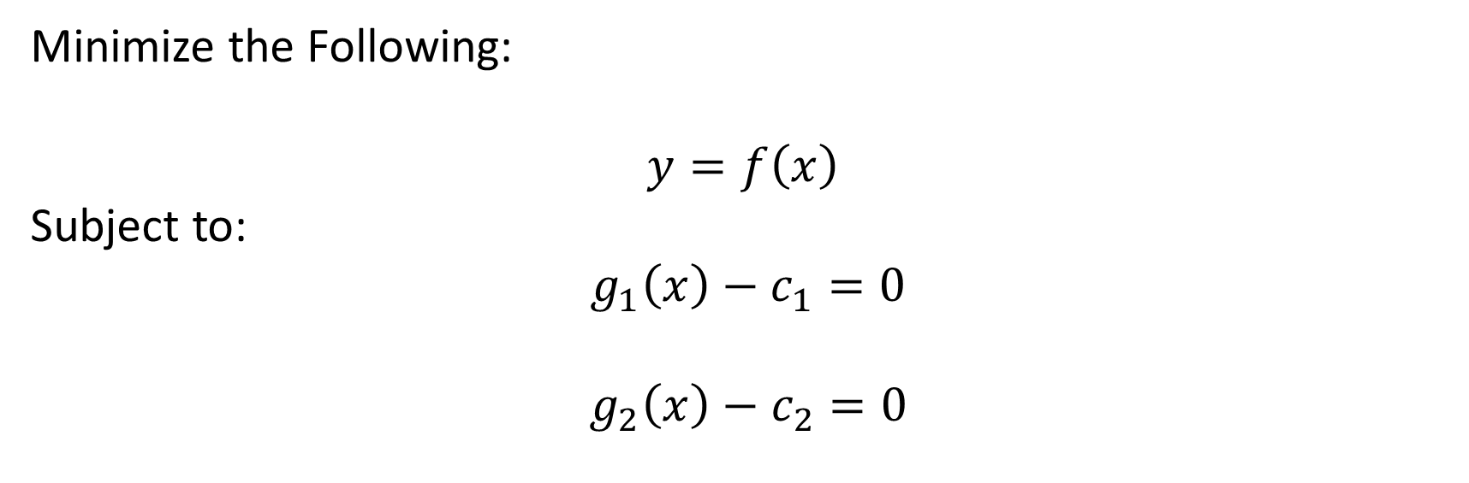
Linear Model with Equality Constraint
Minimize the Following:
$$y=f\left(x\right)$$
Subject to:
$g_{1}\left(x\right)−c_{1}=0$
$g_{2}\left(x\right)−c_{2}=0$

Slide 19
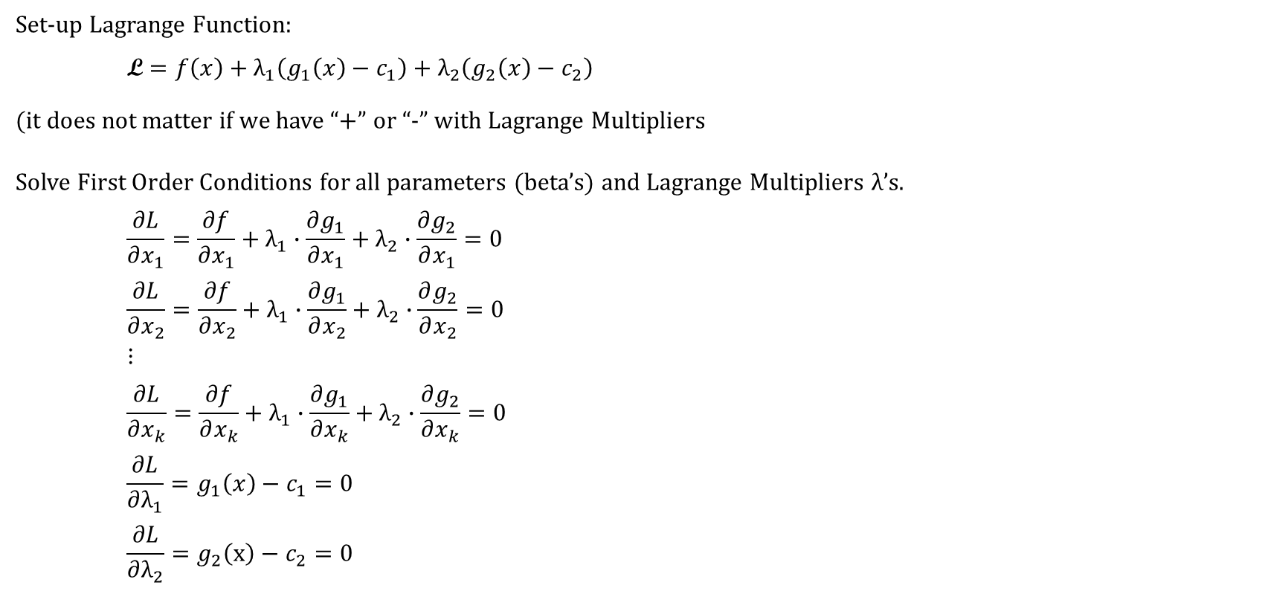
Solve using Lagrange Multipliers
Set-up Lagrange Function:
$$\text{L}=f\left(x\right)+λ_{1}\left(g_{1}\left(x\right)−c_{1}\right)+λ_{2}\left(g_{2}\left(x\right)−c_{2}\right)$$
(it does not matter if we have “+” or “-” with Lagrange Multipliers
Solve First Order Conditions for all parameters (beta’s) and Lagrange Multipliers $λ$’s.
$$\frac{∂L}{∂x_{1}}=\frac{∂f}{∂x_{1}}+λ_{1}∙\frac{∂g_{1}}{∂x_{1}}+λ_{2}∙\frac{∂g_{2}}{∂x_{1}}=0$$
$$\frac{∂L}{∂x_{2}}=\frac{∂f}{∂x_{2}}+λ_{1}∙\frac{∂g_{1}}{∂x_{2}}+λ_{2}∙\frac{∂g_{2}}{∂x_{2}}=0$$
$$⋮$$
$$\frac{∂L}{∂x_{k}}=\frac{∂f}{∂x_{k}}+λ_{1}∙\frac{∂g_{1}}{∂x_{k}}+λ_{2}∙\frac{∂g_{2}}{∂x_{k}}=0$$
$$\frac{∂L}{∂λ_{1}}=g_{1}\left(x\right)−c_{1}=0$$
$$\frac{∂L}{∂λ_{2}}=g_{2}\left(x\right)−c_{2}=0$$

Slide 20
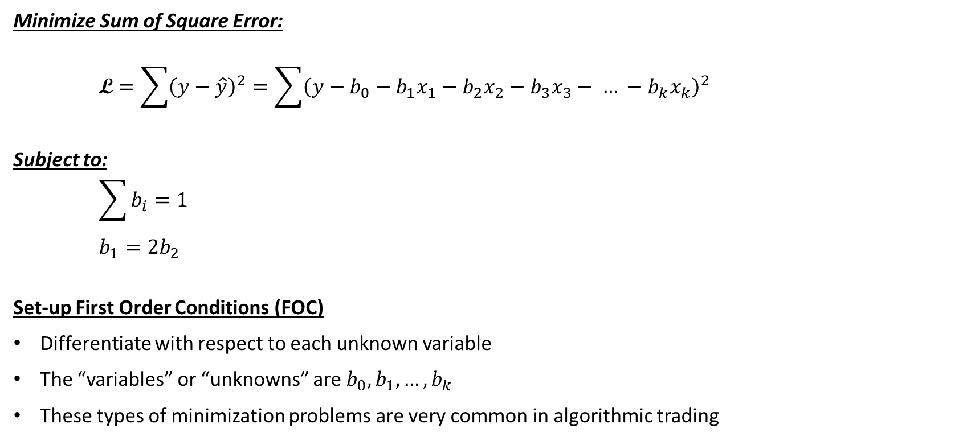
Example: Estimating Linear Model with Equality Constraints
Minimize Sum of Square Error:
$$\text{L}=\sum{{\left(y−\hat{y}\right)}^{2}}=\sum{{\left(y−b_{0}−b_{1}x_{1}−b_{2}x_{2}−b_{3}x_{3}− … −b_{k}x_{k}\right)}^{2}}$$
Subject to:
$$\sum{b_{i}=1}$$
$$b_{1}=2b_{2}$$
Set-up First Order Conditions (FOC)
Differentiate with respect to each unknown variable
The “variables” or “unknowns” are $b_{0}, b_{1}, …, b_{k}$
These types of minimization problems are very common in algorithmic trading

Slide 21


Step 1: Solve for First Order Conditions
Lagrange Function:
$$\text{L}=\sum{{\left(y−b_{0}−b_{1}x_{1}−b_{2}x_{2}−b_{3}x_{3} … −b_{k}x_{k}\right)}^{2}}+λ_{1}\left(b_{0}+b_{1}+b_{2}+b_{3}+ … +b_{k}−1\right)+λ_{2}\left(b_{1}−2b_{2}\right)$$
Solve First Order Conditions for all parameters (beta’s) and Lagrange Multipliers $λ$’s.
$$\frac{∂L}{∂b_{0}}=−2∙\sum{\left(y−b_{0}−b_{1}x_{1}−b_{2}x_{2}− …−b_{k}x_{k}\right)+}λ_{1}=0$$
$$\frac{∂L}{∂b_{1}}=−2∙\sum{\left(y−b_{0}−b_{1}x_{1}−b_{2}x_{2}− … −b_{k}x_{k}\right)∙x_{1}+λ_{1}+λ_{2}}=0$$
$$\frac{∂L}{∂b_{2}}=−2∙\sum{\left(y−b_{0}−b_{1}x_{1}−b_{2}x_{2}− … −b_{k}x_{k}\right)∙x_{2}+λ_{1}−2λ_{2}}=0$$
$$\frac{∂L}{∂b_{3}}=−2∙\sum{\left(y−b_{0}−b_{1}x_{1}−b_{2}x_{2}− … −b_{k}x_{k}\right)∙x_{3}+λ_{1}}=0$$
$$⋮$$
$$\frac{∂L}{∂b_{k}}=−2∙\sum{\left(y−b_{0}−b_{1}x_{1}−b_{2}x_{2}− … −b_{k}x_{k}\right)∙x_{k}+λ_{1}}=0$$
$$\frac{∂L}{∂λ_{1}}=b_{0}+b_{1}+b_{2}+ …+b_{k}−1=0$$
$$\frac{∂L}{∂λ_{2}}=b_{1}−2b_{2}=0$$
Variables to solve are:
$b_{0}, b_{1}, …, b_{k}$, $λ_{1},λ_{2}$
Constants are:
$$y, x_{1}, …, x_{k}$$
Notation:
$$\sum{x=\sum_{i=1}^{n}{x_{ki}}}$$

Slide 22
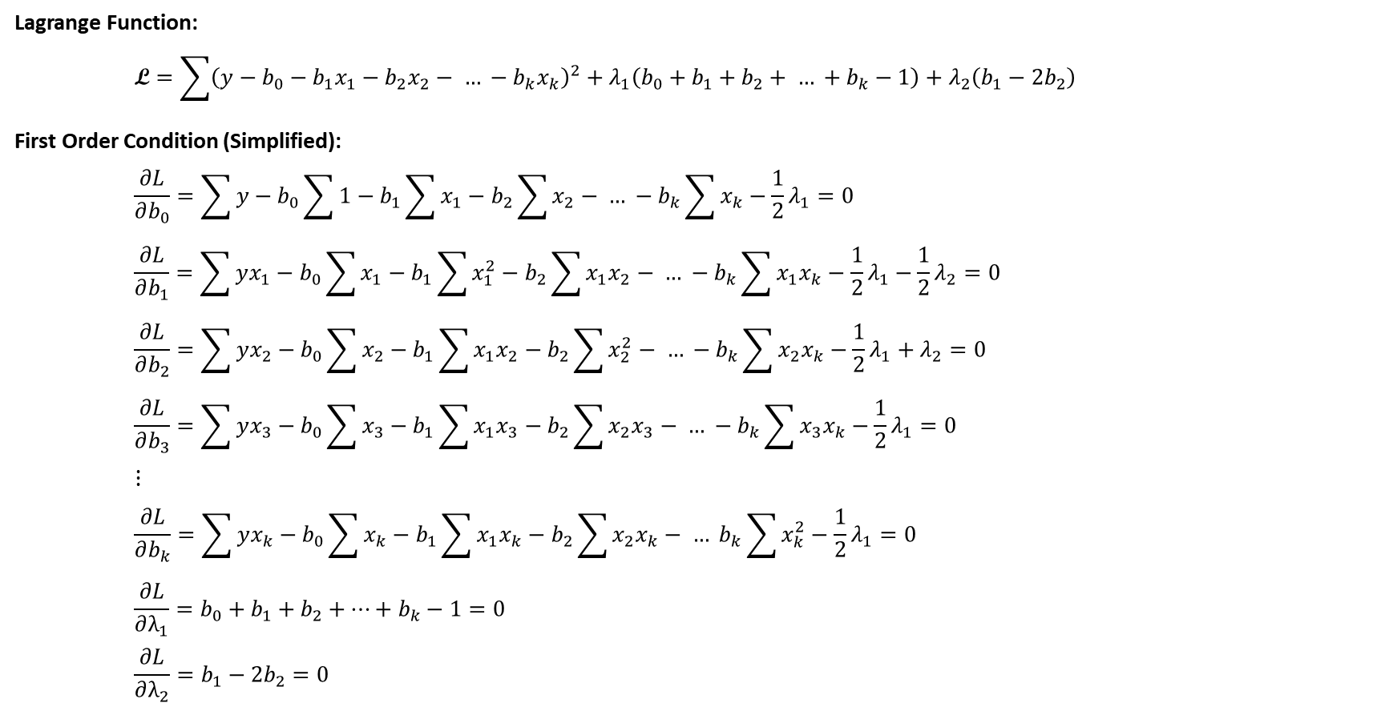

Step 2: Simplify First Order Conditions via factoring through
Lagrange Function:
$$\text{L}=\sum{{\left(y−b_{0}−b_{1}x_{1}−b_{2}x_{2}− … −b_{k}x_{k}\right)}^{2}}+λ_{1}\left(b_{0}+b_{1}+b_{2}+ … +b_{k}−1\right)+λ_{2}\left(b_{1}−2b_{2}\right)$$
First Order Condition (Simplified):
$$\frac{∂L}{∂b_{0}}=\sum{y}−b_{0}\sum{1}−b_{1}\sum{x_{1}}−b_{2}\sum{x_{2}}− … −b_{k}\sum{x_{k}}−\frac{1}{2}λ_{1}=0$$
$$\frac{∂L}{∂b_{1}}=\sum{yx_{1}}−b_{0}\sum{x_{1}}−b_{1}\sum{x_{1}^{2}}−b_{2}\sum{x_{1}x_{2}}− … −b_{k}\sum{x_{1}x_{k}}−\frac{1}{2}λ_{1}−\frac{1}{2}λ_{2}=0$$
$$\frac{∂L}{∂b_{2}}=\sum{yx_{2}}−b_{0}\sum{x_{2}}−b_{1}\sum{x_{1}x_{2}}−b_{2}\sum{x_{2}^{2}}− … −b_{k}\sum{x_{2}x_{k}}−\frac{1}{2}λ_{1}+λ_{2}=0$$
$$\frac{∂L}{∂b_{3}}=\sum{yx_{3}}−b_{0}\sum{x_{3}}−b_{1}\sum{x_{1}x_{3}}−b_{2}\sum{x_{2}x_{3}}− … −b_{k}\sum{x_{3}x_{k}}−\frac{1}{2}λ_{1}=0$$
$$⋮$$
$$\frac{∂L}{∂b_{k}}=\sum{yx_{k}}−b_{0}\sum{x_{k}}−b_{1}\sum{x_{1}x_{k}}−b_{2}\sum{x_{2}x_{k}}− … b_{k}\sum{x_{k}^{2}}−\frac{1}{2}λ_{1}=0$$
$$\frac{∂L}{∂λ_{1}}=b_{0}+b_{1}+b_{2}+…+b_{k}−1=0$$
$$\frac{∂L}{∂λ_{2}}=b_{1}−2b_{2}=0$$
Variables to solve are:
$b_{0}, b_{1}, …, b_{k}$, $λ_{1},λ_{2}$
Constants are:
$$y, x_{1}, …, x_{k}$$
Notation:
$$\sum{x=\sum_{i=1}^{n}{x_{ki}}}$$
Important Note:
$\sum{1}$=n
Do not forget to divided by “-2” throughout
When using Lagrange Multipliers, the -2 does not drop out.

Slide 23
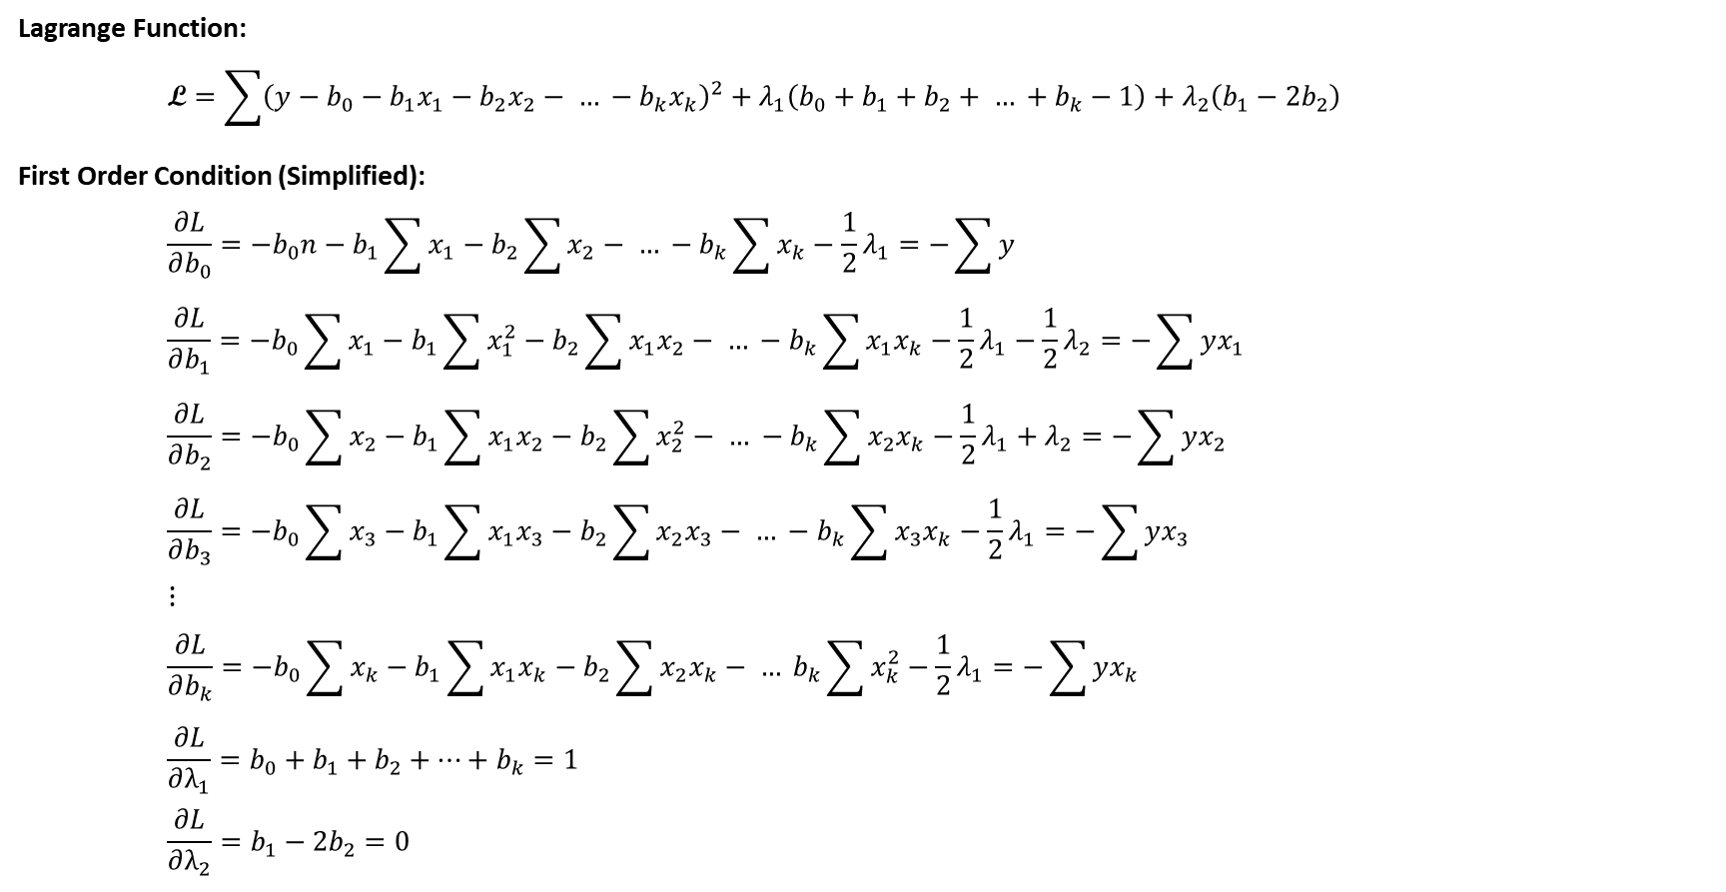

Step 3: Bring all Constant Terms to RHS
Lagrange Function:
$$\text{L}=\sum{{\left(y−b_{0}−b_{1}x_{1}−b_{2}x_{2}− … −b_{k}x_{k}\right)}^{2}}+λ_{1}\left(b_{0}+b_{1}+b_{2}+ … +b_{k}−1\right)+λ_{2}\left(b_{1}−2b_{2}\right)$$
First Order Condition (Simplified):
$$\frac{∂L}{∂b_{0}}=−b_{0}n−b_{1}\sum{x_{1}}−b_{2}\sum{x_{2}}− … −b_{k}\sum{x_{k}}−\frac{1}{2}λ_{1}=−\sum{y}$$
$$\frac{∂L}{∂b_{1}}=−b_{0}\sum{x_{1}}−b_{1}\sum{x_{1}^{2}}−b_{2}\sum{x_{1}x_{2}}− … −b_{k}\sum{x_{1}x_{k}}−\frac{1}{2}λ_{1}−\frac{1}{2}λ_{2}=−\sum{yx_{1}}$$
$$\frac{∂L}{∂b_{2}}=−b_{0}\sum{x_{2}}−b_{1}\sum{x_{1}x_{2}}−b_{2}\sum{x_{2}^{2}}− … −b_{k}\sum{x_{2}x_{k}}−\frac{1}{2}λ_{1}+λ_{2}=−\sum{yx_{2}}$$
$$\frac{∂L}{∂b_{3}}=−b_{0}\sum{x_{3}}−b_{1}\sum{x_{1}x_{3}}−b_{2}\sum{x_{2}x_{3}}− … −b_{k}\sum{x_{3}x_{k}}−\frac{1}{2}λ_{1}=−\sum{yx_{3}}$$
$$⋮$$
$$\frac{∂L}{∂b_{k}}=−b_{0}\sum{x_{k}}−b_{1}\sum{x_{1}x_{k}}−b_{2}\sum{x_{2}x_{k}}− … b_{k}\sum{x_{k}^{2}}−\frac{1}{2}λ_{1}=−\sum{yx_{k}}$$
$$\frac{∂L}{∂λ_{1}}=b_{0}+b_{1}+b_{2}+…+b_{k}=1$$
$$\frac{∂L}{∂λ_{2}}=b_{1}−2b_{2}=0$$
Variables to solve are:
$b_{0}, b_{1}, …, b_{k}$, $λ_{1},λ_{2}$
Constants are:
$$y, x_{1}, …, x_{k}$$
Notation:
$$\sum{x=\sum_{i=1}^{n}{x_{ki}}}$$
Important Note:
$\sum{1}$=n
Do not forget to divided by “-2” throughout
When using Lagrange Multipliers, the -2 does not drop out.

Slide 24
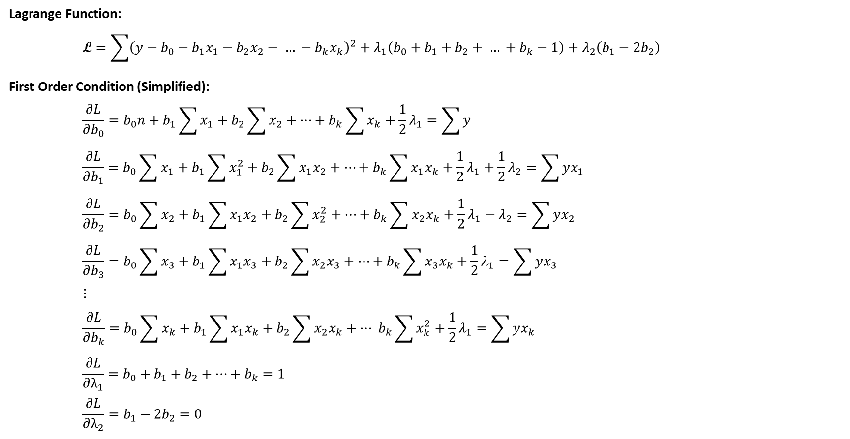

Step 4: Multiply by -1 to Simplify the FOC Equations
Lagrange Function:
$$\text{L}=\sum{{\left(y−b_{0}−b_{1}x_{1}−b_{2}x_{2}− … −b_{k}x_{k}\right)}^{2}}+λ_{1}\left(b_{0}+b_{1}+b_{2}+ … +b_{k}−1\right)+λ_{2}\left(b_{1}−2b_{2}\right)$$
First Order Condition (Simplified):
$$\frac{∂L}{∂b_{0}}=b_{0}n+b_{1}\sum{x_{1}}+b_{2}\sum{x_{2}}+…+b_{k}\sum{x_{k}}+\frac{1}{2}λ_{1}=\sum{y}$$
$$\frac{∂L}{∂b_{1}}=b_{0}\sum{x_{1}}+b_{1}\sum{x_{1}^{2}}+b_{2}\sum{x_{1}x_{2}}+…+b_{k}\sum{x_{1}x_{k}}+\frac{1}{2}λ_{1}+\frac{1}{2}λ_{2}=\sum{yx_{1}}$$
$$\frac{∂L}{∂b_{2}}=b_{0}\sum{x_{2}}+b_{1}\sum{x_{1}x_{2}}+b_{2}\sum{x_{2}^{2}}+…+b_{k}\sum{x_{2}x_{k}}+\frac{1}{2}λ_{1}−λ_{2}=\sum{yx_{2}}$$
$$\frac{∂L}{∂b_{3}}=b_{0}\sum{x_{3}}+b_{1}\sum{x_{1}x_{3}}+b_{2}\sum{x_{2}x_{3}}+…+b_{k}\sum{x_{3}x_{k}}+\frac{1}{2}λ_{1}=\sum{yx_{3}}$$
$$⋮$$
$$\frac{∂L}{∂b_{k}}=b_{0}\sum{x_{k}}+b_{1}\sum{x_{1}x_{k}}+b_{2}\sum{x_{2}x_{k}}+… b_{k}\sum{x_{k}^{2}}+\frac{1}{2}λ_{1}=\sum{yx_{k}}$$
$$\frac{∂L}{∂λ_{1}}=b_{0}+b_{1}+b_{2}+…+b_{k}=1$$
$$\frac{∂L}{∂λ_{2}}=b_{1}−2b_{2}=0$$
Variables to solve are:
$b_{0}, b_{1}, …, b_{k}$, $λ_{1},λ_{2}$
Constants are:
$$y, x_{1}, …, x_{k}$$
Notation:
$$\sum{x=\sum_{i=1}^{n}{x_{ki}}}$$
Important Note:
$\sum{1}$=n
Do not forget to divided by “-2” throughout
When using Lagrange Multipliers, the -2 does not drop out.
Remember to Multiply through the -1

Slide 25
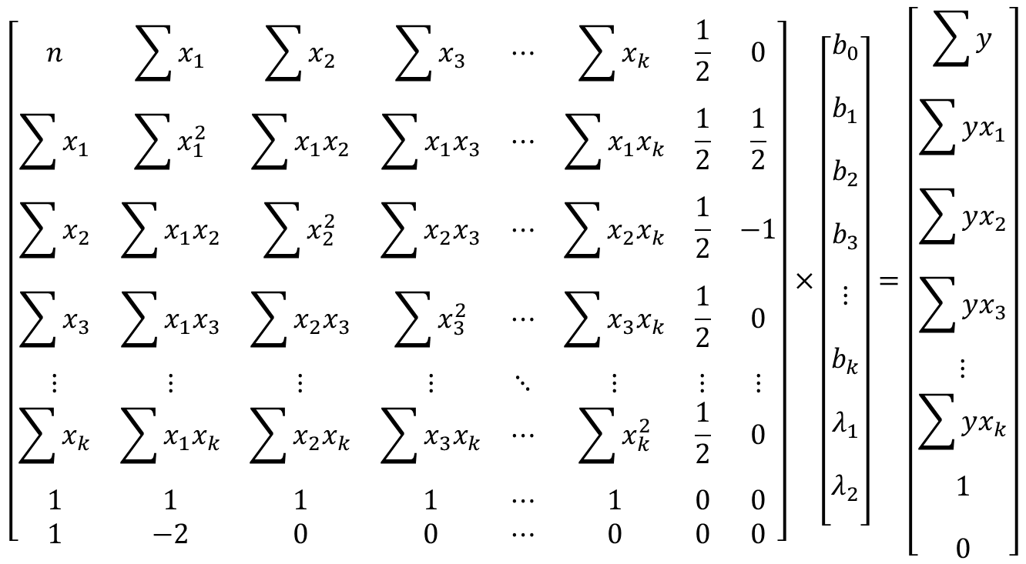
Step 5: Matrix Form
$$X×b=Y$$
$$\left[\begin{matrix}n & \sum{x_{1}} & \sum{x_{2}} & \sum{x_{3}} & ⋯ & \sum{x_{k}} & \frac{1}{2} & 0 \\ \sum{x_{1}} & \sum{x_{1}^{2}} & \sum{x_{1}x_{2}} & \sum{x_{1}x_{3}} & ⋯ & \sum{x_{1}x_{k}} & \frac{1}{2} & \frac{1}{2} \\ \sum{x_{2}} & \sum{x_{1}x_{2}} & \sum{x_{2}^{2}} & \sum{x_{2}x_{3}} & ⋯ & \sum{x_{2}x_{k}} & \frac{1}{2} & −1 \\ \sum{x_{3}} & \sum{x_{1}x_{3}} & \sum{x_{2}x_{3}} & \sum{x_{3}^{2}} & ⋯ & \sum{x_{3}x_{k}} & \frac{1}{2} & 0 \\ ⋮ & ⋮ & ⋮ & ⋮ & ⋱ & ⋮ & ⋮ & ⋮ \\ \sum{x_{k}} & \sum{x_{1}x_{k}} & \sum{x_{2}x_{k}} & \sum{x_{3}x_{k}} & ⋯ & \sum{x_{k}^{2}} & \frac{1}{2} & 0 \\ 1 & 1 & 1 & 1 & ⋯ & 1 & 0 & 0 \\ 1 & −2 & 0 & 0 & ⋯ & 0 & 0 & 0\end{matrix}\right]×\left[\begin{matrix}\begin{aligned}b_{0} \\ \end{aligned} \\ \begin{aligned}b_{1} \\ \end{aligned} \\ \begin{aligned}b_{2} \\ \end{aligned} \\ \begin{aligned}b_{3} \\ \end{aligned} \\ \begin{aligned}⋮ \\ \end{aligned} \\ \begin{aligned}b_{k} \\ \end{aligned} \\ \begin{aligned}λ_{1} \\ \end{aligned} \\ \begin{aligned}λ_{2} \\ \end{aligned}\end{matrix}\right]=\left[\begin{matrix}\sum{y} \\ \sum{yx_{1}} \\ \sum{yx_{2}} \\ \sum{yx_{3}} \\ ⋮ \\ \sum{yx_{k}} \\ \begin{aligned}1 \\ \end{aligned} \\ 0\end{matrix}\right]$$

Slide 26
Step 6: Solving Parameters via Matrix Multiplication
$$Xb=Y$$
$$X^{′}Xb=X^{′}Y$$
$${\left(X^{′}X\right)}^{−1}X^{′}Xb={{\left(X^{′}X\right)}^{−1}X}^{′}Y$$
$$b={{\left(X^{′}X\right)}^{−1}X}^{′}Y$$

Slide 27
Review: Linear Regression with Equality Constraints
Solving a Minimization Equation with Equity Constraints
Set-up Lagrange Multiplier Equation
Calculate First Order Conditions (FOC)
Set FOC equal to zero
Simplify Equations where possible
Now we have N equations and N unknowns, so we can solve via:
Row-Reduction Techniques
Matrix Multiplication
Important Notes:
In general, we need to verify that the solution is either a Minimum or Maximum solution.
Setting up the Lagrange Multipliers is the same for Maximize and Minimize Optimization problems.
Verify that the solution is a local or global minimum or maximum value.
We can only solve the set of n-equations and n-unknows if all explanatory variables are independent, otherwise, we can not ensure accuracy of the estimated parameter values. E.g.,
X Matrix columns are all linearly independent
X Matrix has full rank.
Compute Regression statistics and verify the results satisfy all OLS properties.

Slide 28
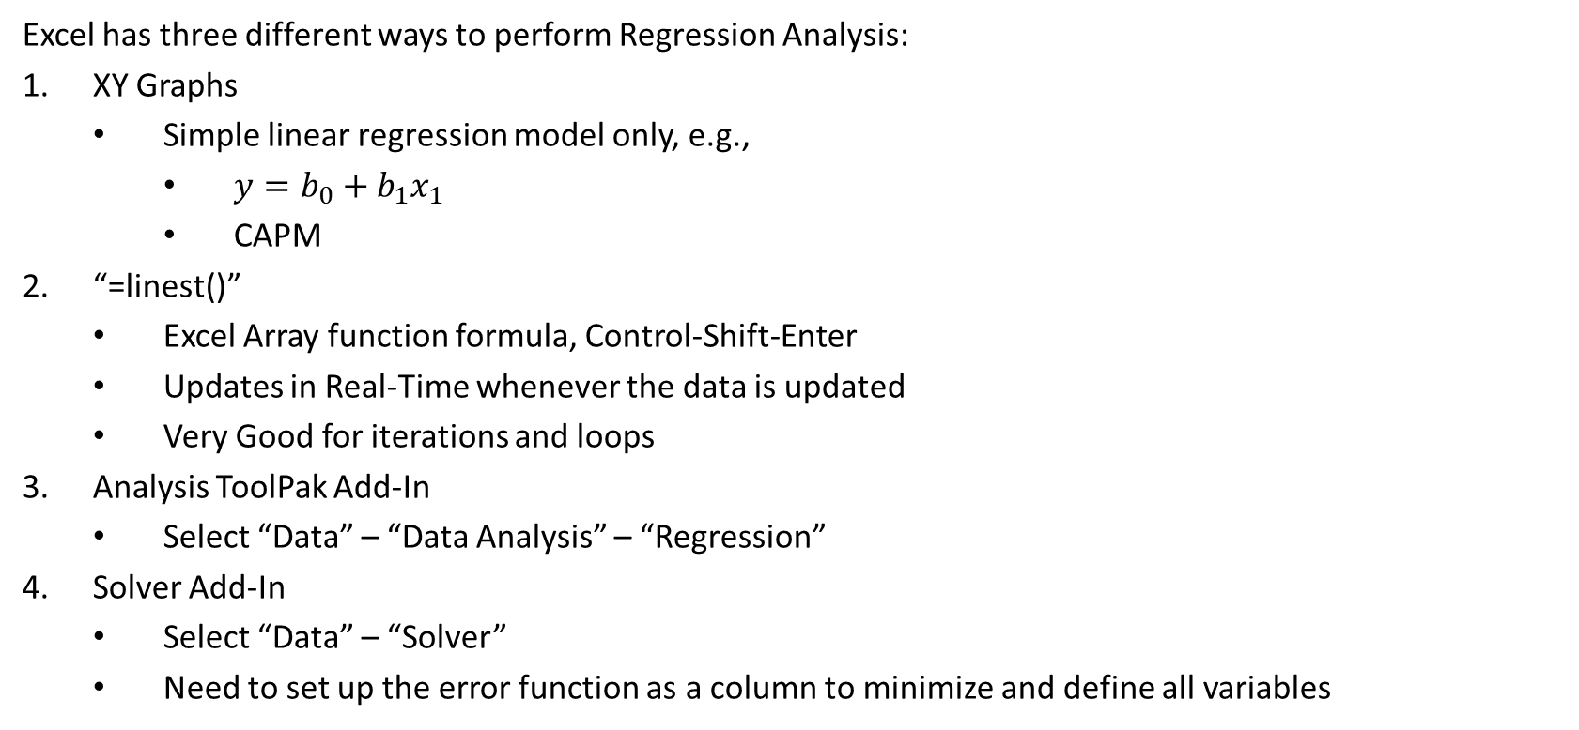
Regression in Excel
Excel has three different ways to perform Regression Analysis:
XY Graphs
Simple linear regression model only, e.g.,
$y=b_{0}+b_{1}x_{1}$
CAPM
“=linest()”
Excel Array function formula, Control-Shift-Enter
Updates in Real-Time whenever the data is updated
Very Good for iterations and loops
Analysis ToolPak Add-In
Select “Data” – “Data Analysis” – “Regression”
Solver Add-In
Select “Data” – “Solver”
Need to set up the error function as a column to minimize and define all variables

Slide 29
Regressions in MATLAB
MATLAB has several different ways to Run Regressions:
Regress()
Need to add the constant column of 1’s
Regstats()
Need to specify the regression statistics to show
Fitlm()
Provides regression output in table form

Slide 30
Log-Linear Regression

Slide 31

Log-Linear Model:
Log-Linear Regression Model (Power Function):
$$Y=b_{0}∙X_{1}^{b1}∙X_{2}^{b2}∙e^{u}$$
$$ln(u)\sim N\left(0,σ^{2}\right)$$
$Y=$ dependent variable
$X_{1}, X_{2}=$ explanatory factors
$b_{0},b_{1}, b_{2}=$ model parameters
$e^{u}=$ model error term

Slide 32
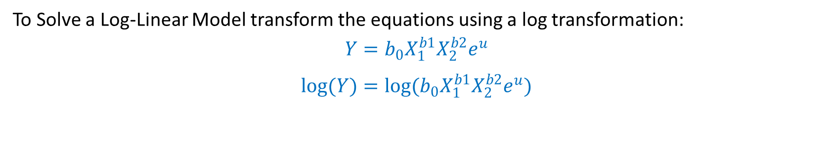
Log-Linear Model:
To Solve a Log-Linear Model transform the equations using a log transformation:
$$Y=b_{0}X_{1}^{b1}X_{2}^{b2}e^{u}$$
$$log(Y)=log(b_{0}X_{1}^{b1}X_{2}^{b2}e^{u})$$

Slide 33
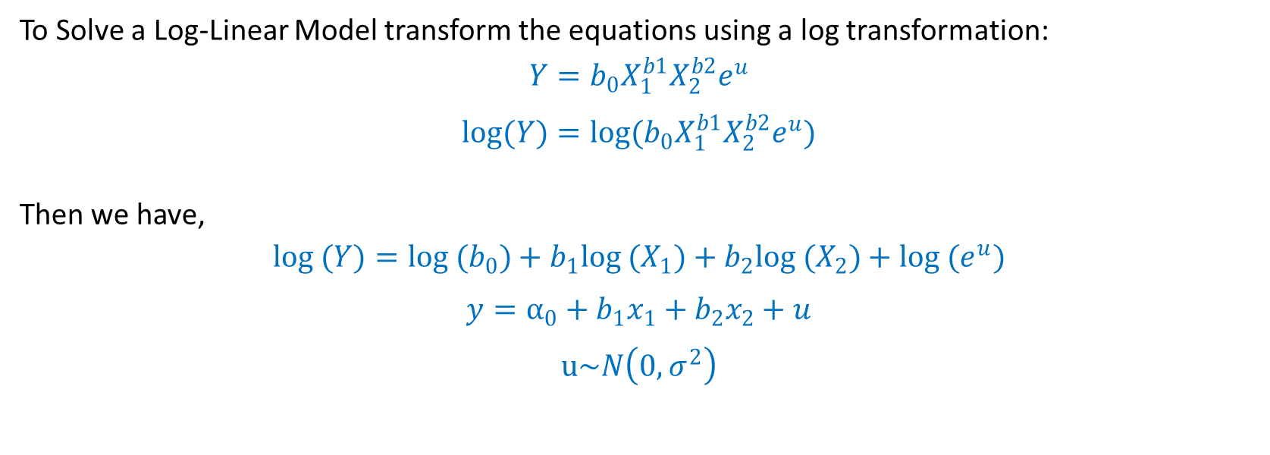
Log-Linear Model:
To Solve a Log-Linear Model transform the equations using a log transformation:
$$Y=b_{0}X_{1}^{b1}X_{2}^{b2}e^{u}$$
$$log(Y)=log(b_{0}X_{1}^{b1}X_{2}^{b2}e^{u})$$
Then we have,
$$log (Y)={log (b}_{0})+b_{1}log (X_{1})+b_{2}log (X_{2})+log (e^{u})$$
$$y=α_{0}+b_{1}x_{1}+b_{2}x_{2}+u$$
$$u\sim N\left(0,σ^{2}\right)$$

Slide 34
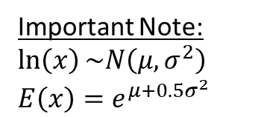
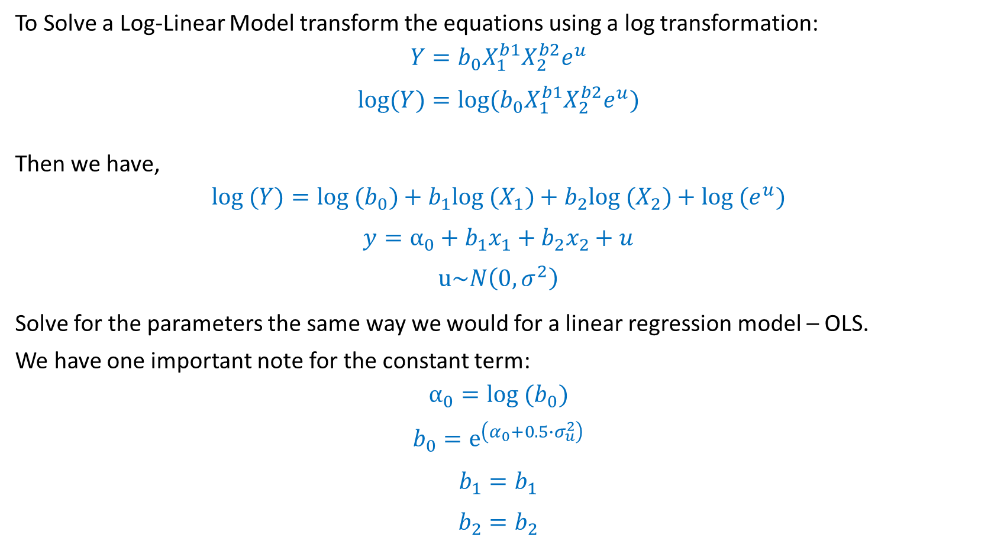
Log-Linear Model:
To Solve a Log-Linear Model transform the equations using a log transformation:
$$Y=b_{0}X_{1}^{b1}X_{2}^{b2}e^{u}$$
$$log(Y)=log(b_{0}X_{1}^{b1}X_{2}^{b2}e^{u})$$
Then we have,
$$log (Y)={log (b}_{0})+b_{1}log (X_{1})+b_{2}log (X_{2})+log (e^{u})$$
$$y=α_{0}+b_{1}x_{1}+b_{2}x_{2}+u$$
$$u\sim N\left(0,σ^{2}\right)$$
Solve for the parameters the same way we would for a linear regression model – OLS.
We have one important note for the constant term:
$$α_{0}{=log (b}_{0})$$
$$b_{0}=e^{\left(α_{0}+0.5∙σ_{u}^{2}\right)}$$
$$b_{1}=b_{1}$$
$$b_{2}=b_{2}$$
Important Note:
$$\ln\left(x\right)\sim N\left(μ,σ^{2}\right)$$
$$E\left(x\right)=e^{μ+0.5σ^{2}}$$

Slide 35
Logit Probability Models

Slide 36
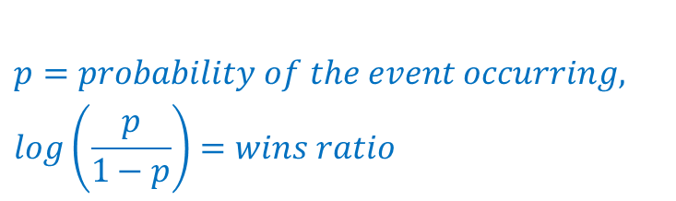

Probability Model:
Solving a Probability Model with a Single Variable:
Transform the Probability Model into a linear model via log transformation using the Wins-Ratio:
This is:
$$p=\frac{1}{1+e^{−z}}$$
Then,
$$1−p=1−\frac{1}{1+e^{−z}}=\frac{e^{−z}}{1+e^{−z}}$$
Finally,
$$\frac{p}{1−p}=\frac{\frac{1}{1+e^{−z}}}{\frac{e^{−z}}{1+e^{−z}}}=e^{z}$$
We can now solve via a log-transformation:
$$log\left(\frac{p}{1−p}\right)=z$$
$$p=probability of the event occurring,$$
$$log\left(\frac{p}{1−p}\right)=wins ratio$$

Slide 37
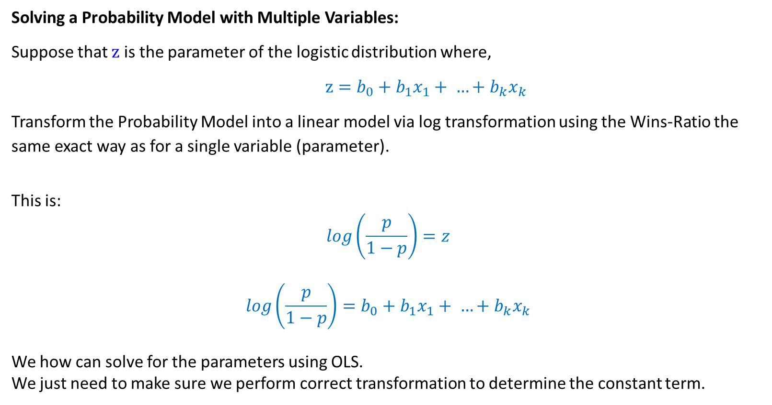
Probability Model:
Solving a Probability Model with Multiple Variables:
Suppose that $z$ is the parameter of the logistic distribution where,
$z=b_{0}+b_{1}x_{1}+ …+b_{k}x_{k}$
Transform the Probability Model into a linear model via log transformation using the Wins-Ratio the same exact way as for a single variable (parameter).
This is:
$$log\left(\frac{p}{1−p}\right)=z$$
$$log\left(\frac{p}{1−p}\right)=b_{0}+b_{1}x_{1}+ …+b_{k}x_{k}$$
We how can solve for the parameters using OLS.
We just need to make sure we perform correct transformation to determine the constant term.

Slide 38
Probability Model – Binary Model

Slide 39
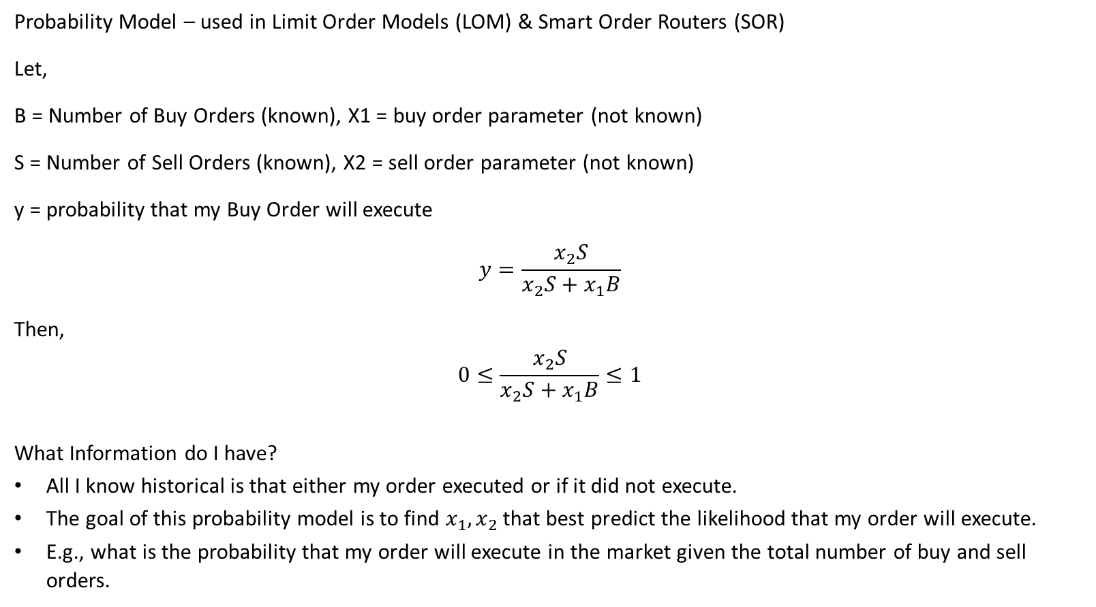
Probability Model – Binary Model:
Probability Model – used in Limit Order Models (LOM) & Smart Order Routers (SOR)
Let,
B = Number of Buy Orders (known), X1 = buy order parameter (not known)
S = Number of Sell Orders (known), X2 = sell order parameter (not known)
y = probability that my Buy Order will execute
$$y=\frac{x_{2}S}{x_{2}S+x_{1}B}$$
Then,
$$0≤\frac{x_{2}S}{x_{2}S+x_{1}B}≤1$$
What Information do I have?
All I know historical is that either my order executed or if it did not execute.
The goal of this probability model is to find $x_{1}, x_{2}$ that best predict the likelihood that my order will execute.
E.g., what is the probability that my order will execute in the market given the total number of buy and sell orders.

Slide 40

Probability Model – Binary Model:
Observations:
$$y=\left\{\begin{matrix}1 & if order executed \\ 0 & if order did not execute\end{matrix}\right.$$
Model:
$$y=\left\{\begin{matrix}\frac{x_{2}S}{x_{2}S+x_{1}B} & if order executed \\ 1−\frac{x_{2}S}{x_{2}S+x_{2}B}=\frac{x_{1}B}{x_{2}S+x_{1}B} & if order did not execute\end{matrix}\right.$$
How do we solve this model?
We use maximum likelihood estimates (MLE) and solve using logs
$$Max L= \prod_{i=1}^{N}{y_{i}}$$
$$Max logL= \sum_{i=1}^{n}{\log\left(y_{i}\right)}$$

Slide 41

Probability Model - Example
Solving using Maximum Likelihood Estimation:
If,
$$L=\prod_{i=1}^{n}{y_{i}}=y_{1}∙y_{2}∙y_{3}∙ … ∙y_{n}$$
Then,
$$\log\left(L\right)=\sum_{i=1}^{n}{\log\left(y_{i}\right)}=\log\left(y_{1}\right)+\log\left(y_{2}\right)+\log\left(y_{3}\right)+ …+\log\left(y_{n}\right)$$

Slide 42
Excel Spreadsheet Examples

